Slide 1
Presentation on Enumeration Methodology
MINISTRY OF PLANNING, DEVELOPMENT
& SPECIAL INITIATIVES
Dated: 24-08-2021

Slide 2
Progress Made so far….
The recommendations of the Committee were deliberated in detail in 7th meeting held on 15th July 2021
After Consensus broader recommendations presented to Minister PD&SI on same day
As per directions of the Minister PD&SI , presentation on Optimum use of technology was presented to Minister IT&T and Chairman NADRA on 2nd August 2021
Broader recommendations of the committee were presented initially virtually to all Chief Secretaries & their teams on 13th August 2021
Notes:
2
2

Slide 3
Progress Made so far….
Minister PD&SI directed to deliberate in detail regarding Data Enumeration Methodology i.e.
De-jure and De-facto with pros & cons
Notes:
3
3

Slide 4
De-Facto Methodology …
This De-Facto methodology of census is a concept under which individuals are recorded (or are attributed) to the geographical area where they are present at specified time.”
People counted where they are found on the defined census date.
one date for enumeration throughout the country
Turkey(2001) & Bolivia (2012) has used this technique by imposing one-day curfew in the country.
Notes:
4
4

Slide 5
Pros & Cons of De-Facto Methodology …
Pros | Cons
It is not time consuming because the entire enumeration work is done within one day. Persons present at other places within the country are enumerated It allows to cover people who are using the services and facilities of the particular area on almost daily basis but they do not have usual place of residence in that area. | Not comparable with previous census results persons who are travelling in trains, buses and aero planes cannot be enumerated. Requires larger number of forces for curfew and trained enumerators. Due to paucity of time very short questionnaire administered Short period of one day, the census work may not be completed and the staff may fill up the gaps of their own based on guess. over counting of population No information on usual residence
Notes:
5
5

Slide 6
Pros & Cons of De-Facto Methodology …
In Pakistan one block is consist of 200-250 houses, for adopting de-facto approach and to cover population possibly in one or two days then:
One block need to be divided into 5 to 6 blocks.
Maps will have to be updated according to the new blocks
Higher number of enumerators required due to increase in blocks.
Bifurcation of blocks and updating of maps of around 180000 blocks is not possible keeping in view the challenging timelines.
Notes:
6
6

Slide 7
De-Jure Methodology …
A De-jure method of enumeration counts people according to their usual residence which is defined as the place where he/she has lived continuously for at least six months (not including temporary absences for holidays or work).
Intention to live for at least six months+ in the place is to be considered as usual residence.
A person with two homes - one in Islamabad and one in Karachi - that only spends limited time in one location is counted where they use the most resources.
Under this method, the enumeration period of two or three weeks is fixed.
Enumerators collect information from households by visiting them very often to fill up the various schedules.
Persons residing temporarily at a place are not enumerated.
Notes:
7
7

Slide 8
Pros & Cons of De-Facto Methodology …
Pros | Cons
Real data collection as enumerators are given sufficient time to collect information from the households by making frequent visits to them. Results will be comparable with previous censuses. Provides information about Usual Place of residence Detailed information can be collected Comparative studies depict that majority countries are using this methodology as its reflects true ground reality | Extensive training is required for trainers to explain the concept of Usual place of Residence Persons who are not residing permanently at a place at the time of enumeration are usually left out. People may migrate during Census operations and there are chances of double counting Time precision w.r.t reference data is necessary to cover the people/ events(births/deaths) as the actual enumeration may take days or weeks. Day time population using the resources (roads, hospitals, water etc.) of particular area whole day due to their work not counted in the they city where they use resources
Notes:
8
8

Slide 9
Comparative Studies…
Srilanka used de-facto approach till 2001 but shifted to De-jure in 2011 to cover the actual population as per usual place of residence
Turkey used de-facto approach till 2000 but due to its limitations including the fact that information could only be collected on the enumeration date.
Bangladesh used De-facto in all census till 2000 but amended it and in 2011 to cover household members who were on board and on duty were counted in their respective households.
In 2021 planned to use de-jure methodology
Notes:
9
9

Slide 10
Recommendation…
For comparability of results with previous census
&
Based on Comparative studies, that majority of regional/ global countries are using de-jure methodology for complete coverage and effective planning.
PBS/ Census Committee recommended to adopt De-jure methodology
Notes:
10
10

Slide 11
THANK YOU

Slide 12
Issues
…
By counting population through de-jure method, the reported population is according to where people sleep (night time population) rather than where they work (daytime population).
For this reason, the population of central cities is usually far less than the number employed there and that of suburbs far more than those employed in suburbs.
Notes:
12
12

Slide 13
Way Forward
Possible solution for this problem is to use mix mode by adding “Usual place of residence” code in questionnaire of Resident Status
Resident Status of person
Present =1 ( usual resident)
Temporarily Absent at the time of enumeration =2
and Visitor=3
In this way the de-facto population is calculated using code 1& 3,.
De-jure population will be calculated by adding 1 & 2
Comprehensive training will be needed for clarity of concepts
This question was added in 1998 census.
India has also used the same methodology in 2001 census which spread from 9th to 28th February 2001.
Notes:
13
13

Slide 14
Method of Enumeration in different Countries
Country |  | De-Jure | De-Facto | Remarks
 | BANGLADESH | . | till 2001 | Used mixed approach in 2011 , however using De-jure in 2021 Census
 | India | . | -
 | Iran | . | -
 | Pakistan | . | 1951 used mixed approach
 | USA | . | -
 | UK | . | - | Using de-jure since 1931
 | Australia | . | -
 | Turkey | . | till 2000 | Used addressed based register since 2016
 | Sri Lanka | . | till 2001
Notes:
14
14

Slide 15
REVIEW OF REGIONAL COUNTRIES- FIELD OPERATION MECHANISM
Country | BANGLADESH 2021 | INDIA 2021 | IRAN 2016 | PAKISTAN 2017
Involvement of Stakeholders | Digitization of documentation of Census reports The expert committee decided for the census in consultation with the experts and stakeholders. | The data users’ conference with various stakeholders( Central ministries, state governments, academic institutions and International Organizations ) | All stakeholders were involved | Key stakeholder were involved International workshop for whole census process July 2016
Trainers | 470,000 | 98 National Trainer, 1800 master trainers 43,500 field trainers, 30 lac enumerators | 324 Master Trainers 3500 trainers 22,000 enumerators | Master Trainers – 65 Trainers – 700 120,000 field staff
Modern Technology for Training | √ | √ Enumerator will use own devices | √ 47% data collection through internet(self enumeration) | Manual using ICR Forms
Staff | Teachers | Teachers | Diploma, degree holder staff, Male: 57%, Female : 43% | Teachers (2% Female)
Monitoring /Web portal | √ | √ | √
Post Evaluation | √ | √ | √

Slide 16
Limitations of De-Facto methodology _Turkey
One-day full enumeration with national curfew till 2000
No information on usual residence (de jure)
Large number of staff (approximately One million staff including enumerators, supervisors , trainers, forces and TurkStat was used for population of 68 million approximately
High cost
Over counting
Notes:
16
16

Slide 17
Limitations of De-Facto methodology _Turkey
Notes:
17
17

Slide 18
Limitations of De-Facto methodology _Bolivia
One-day full enumeration with national curfew on 21st November 2012
No information on usual residence (de jure)
Large number of staff (approximately 217000 enumerators and 36000 police officers used for population of 10 million approximately
Notes:
18
18

Slide 19
Way Forward
Possible solution for this problem is to use mix mode by adding “Usual place of residence” code in questionnaire of Resident Status
Resident Status of person
Present =1 ( usual resident)
Temporarily Absent at the time of enumeration =2
and Visitor=3
In this way the de-facto population is calculated using code 1& 3, on the assumption that the temporarily absent will be covered elsewhere in the country.
While de-jure population will be calculated by adding 1 & 2 and excluding visitors from the population during the analysis.
Comprehensive training will be needed to clarify the concepts regarding the three codes for quality data collection.
This question was added in 1998 census, India has also used the same methodology in 2001 census which spread from 9th to 28th February 2001.
Notes:
19
19

Slide 20
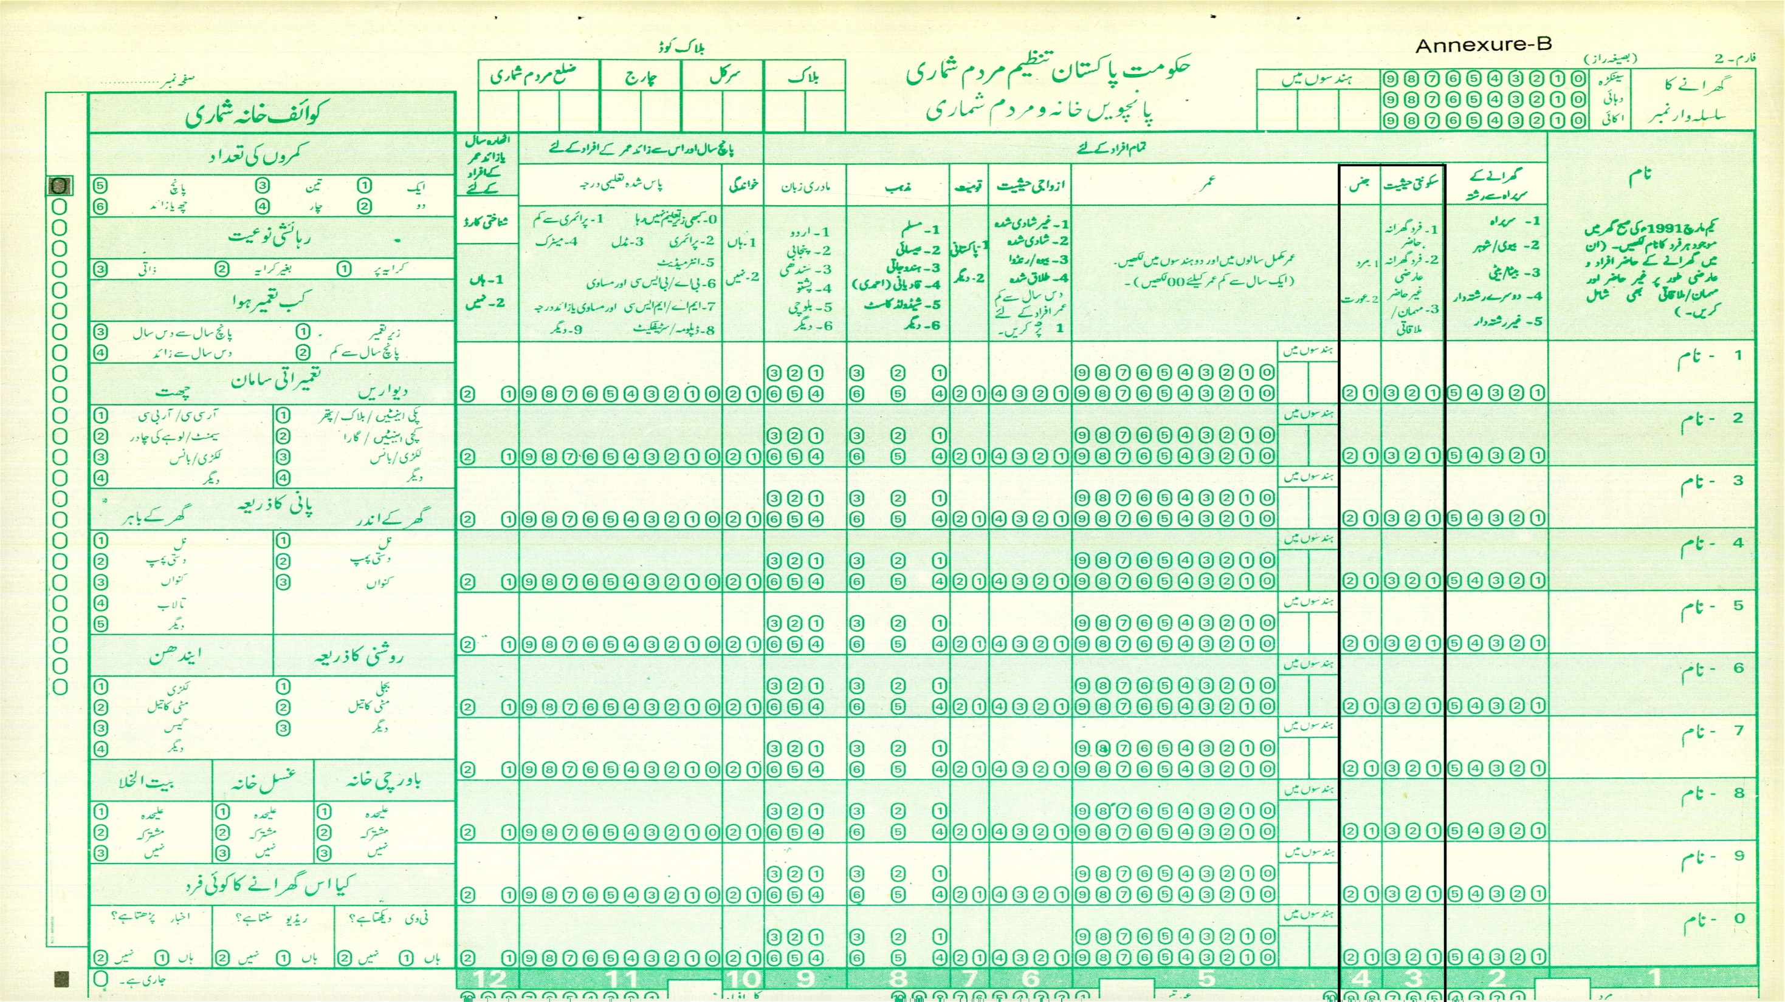

Slide 21
REVIEW OF REGIONAL COUNTRIES- FIELD ENUMERATION MECHANISM
Country | BANGLADESH 2021 | INDIA 2021 | IRAN 2016 | PAKISTAN 2017
Planning | 2 years | 2 years | 5 years | Since 2008
Periodicity | Ten Years | Ten Years | five years | Ten years
Pilot Survey | √ | √ | √
Method of Enumeration | De- jure | De- jure | De- jure | De- jure
Frame Hierarchy | Country, Divisions, Districts , City Corporations ,upazilas | Country , Province , Districts ,Sub District/ Tehsil/ Talukas , Villages | Province, Sub-province City/ Urban area, Rural ,Village, Avenue, Street, Floor/ Apartment, Postal code, Household’s fixed, telephone number | Province, Division, Admin District, Census District/Tehsil, Charge, Circle, Block
Enumeration Areas/blocks | 4,00,000/120 houses | 2,500,000/150-180 houses | 95,192/100 houses | 168,943/200-250 houses
Digitize Maps | √ | Blocks Boundaries formation/ frame updations completed one year before the census | √ | Digital (urban) and manual Map (rural).Updation of urban completed in 2013 and rural blocks was initiated in 2015 but not completed
7

Slide 22
REVIEW OF DEVELOPED COUNTRIES- FIELD OPERATION MECHANISM
Country | USA April 2020 | UK (2021 Postponed) | Australia, August 2021
Planning | 2015-2020 | 2015-2020 | 6 years/before releasing 2016
Frequency | Ten Years | Ten Years | Five years
Method of Enumeration | De- jure | De- jure | De- jure
Method | Use satellite and GPS imagery in 2020 census to identify areas with changes Verification of those addresses in person. | An invitation to complete the form online providing a unique access code (UAC) and website address. | Unique id code sent to household for self enumeration .
Online & Paper | √ | √ | √
Field Work | Internet based, For non response and areas without internet access paper based questionnaire were sent | Internet based Sign Language questionnaire used as well | Internet based, For non response and areas without internet access paper based questionnaire were sent
Staff | Hired temporary and part time workers Retirees, College students job less Flexible working hours include days/ evenings/ weekends. | Any one can register online and training | Hiring 30,000 field staff, online registration and training
Technology | Census takers use secure smartphones Special software is designed to optimize assignments, and real time monitoring software was used to avoid multiple responses for the same person across census records | Online application, Dashboards | OCT 2020 pretest 0.1 million household A separate Data Operations Centre will process the information collected from all digital and paper Census forms.
9

